Slide 1
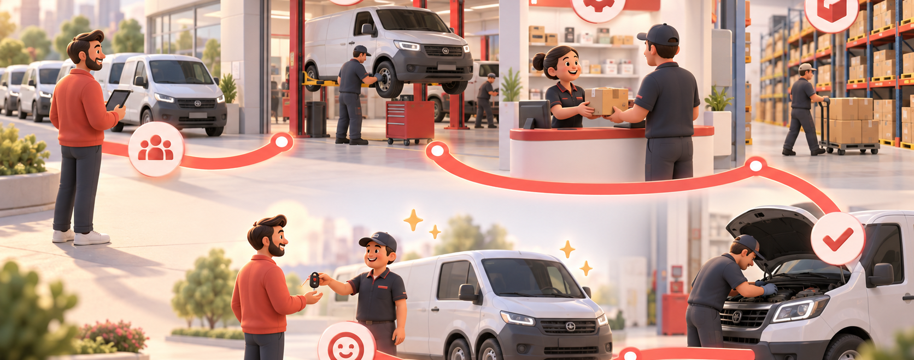
The dealer journey is where GPS is won or lost.
A service-design view of UMI: make the right genuine part the easiest choice.
ISZE / UMI Sales Review Prototype
source: UMI Sales Review FY2027
Notes:
[Sources]
- Source deck: ISZE_UMI_Sales_Review_FY2027_ModeA_only.pptx. UMI review title and meeting context: lines 23-25.
- FY2027 YTD and budget/LY figures: lines 55-65.
- Commercial parts performance: lines 70-80.
- Category movers: lines 85-150.
- GPS, service-parts coverage, IDS and fleet/target data: lines 176-235 and 240-276.
- SPA and Sales-to-Dealer ask: lines 286-345.

Slide 2
Journey map: from vehicle job to genuine-parts purchase
At every step, the customer can leak to a local alternative or a delayed order.
1
2
3
4
5
6
Fleet need
Dealer quote
Part availability
Price check
Repair complete
Repeat order
risk: stock
risk: price
Pain point
Evidence gap
Fix
service gaps
dealer sales data
service-pack offer
brake rotor / air filter
not available for FY2026
pilot by category
ISZE / UMI Sales Review Prototype
source: UMI Sales Review FY2027
Notes:
[Sources]
- Source deck: ISZE_UMI_Sales_Review_FY2027_ModeA_only.pptx. UMI review title and meeting context: lines 23-25.
- FY2027 YTD and budget/LY figures: lines 55-65.
- Commercial parts performance: lines 70-80.
- Category movers: lines 85-150.
- GPS, service-parts coverage, IDS and fleet/target data: lines 176-235 and 240-276.
- SPA and Sales-to-Dealer ask: lines 286-345.

Slide 3
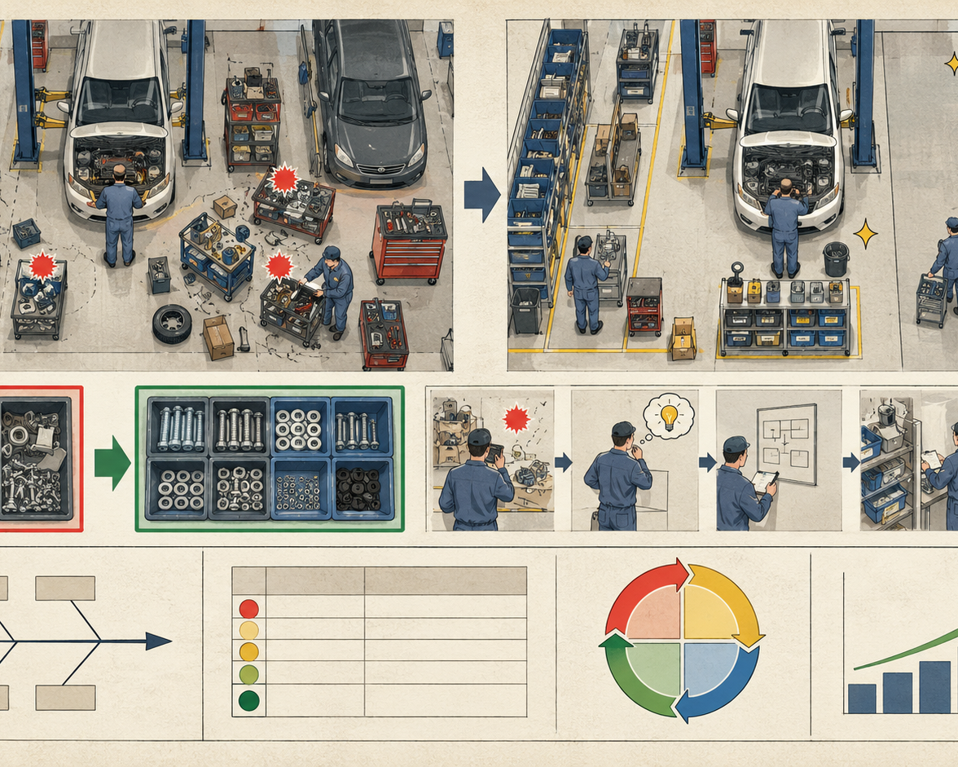
Design the offer around dealer behaviour
A service-pack is easier to sell than a long list of part-number problems.
ISZE / UMI Sales Review Prototype
source: UMI Sales Review FY2027
Notes:
[Sources]
- Source deck: ISZE_UMI_Sales_Review_FY2027_ModeA_only.pptx. UMI review title and meeting context: lines 23-25.
- FY2027 YTD and budget/LY figures: lines 55-65.
- Commercial parts performance: lines 70-80.
- Category movers: lines 85-150.
- GPS, service-parts coverage, IDS and fleet/target data: lines 176-235 and 240-276.
- SPA and Sales-to-Dealer ask: lines 286-345.

Slide 4
Customer conversation: four asks, framed as shared benefit
UMI should feel that the data request improves their dealer network, not just ISZE reporting.
Shared-benefit asks
For UMI
better availability
Close Shell price hold
fast movers visible
Pick first service-parts pilot
Return SPA counter-list
For ISZE
sharper SPA
Share Sales-to-Dealer data
fact-based target
ISZE / UMI Sales Review Prototype
source: UMI Sales Review FY2027
Notes:
[Sources]
- Source deck: ISZE_UMI_Sales_Review_FY2027_ModeA_only.pptx. UMI review title and meeting context: lines 23-25.
- FY2027 YTD and budget/LY figures: lines 55-65.
- Commercial parts performance: lines 70-80.
- Category movers: lines 85-150.
- GPS, service-parts coverage, IDS and fleet/target data: lines 176-235 and 240-276.
- SPA and Sales-to-Dealer ask: lines 286-345.

